Slide 1
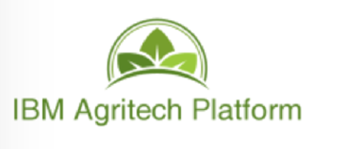
PERCIVAL LUCENA PLUCENA@BR.IBM.COM @PLUCENA
Notes:
This is a high level introduction to blockchain concepts and business value. Presentations in this series are:
Blockchain Explained: High level introduction to blockchain for business
Blockchain Solutions: Use-cases, references and how IBM can help
Blockchain Composed: A technical introduction to Hyperledger Composer
Blockchain Architected: A technical introduction to the concepts and components of a blockchain solution
Blockchain Explored: A technical deep dive on Hyperledger Fabric
Blockchain Next Steps: How to proceed on a first project
There is much hype around Blockchain. Most of this relates to the use of Blockchain to underpin the Bitcoin cryptocurrency. Whilst IBM are not interested in cryptocurrency, we are very interested in exploring the broader business application of blockchain technology. This is a transformational opportunity for many of our clients.
IBM is a recognized leader in making blockchain real for business. We are helping many hundreds of clients on their blockchain journeys.
This presentation is the first step! IBM has lots of educational material (signified by the breadcrumb trail at the top of this chart) and a well-defined engagement process that will help. We will take you through all of this later on in this presentation.
The latest copy of this presentation can be found on the IBM intranet at https://ibm.box.com/v/BlockchainExplained. Feel free to distribute a PDF of this file to clients.
This presentation uses the IBM Plex font family, which can be downloaded here: https://ibm.ent.box.com/s/j90l2qhgjfysu6laq1rnt1anxspqxdcb/folder/30078036973

Slide 2
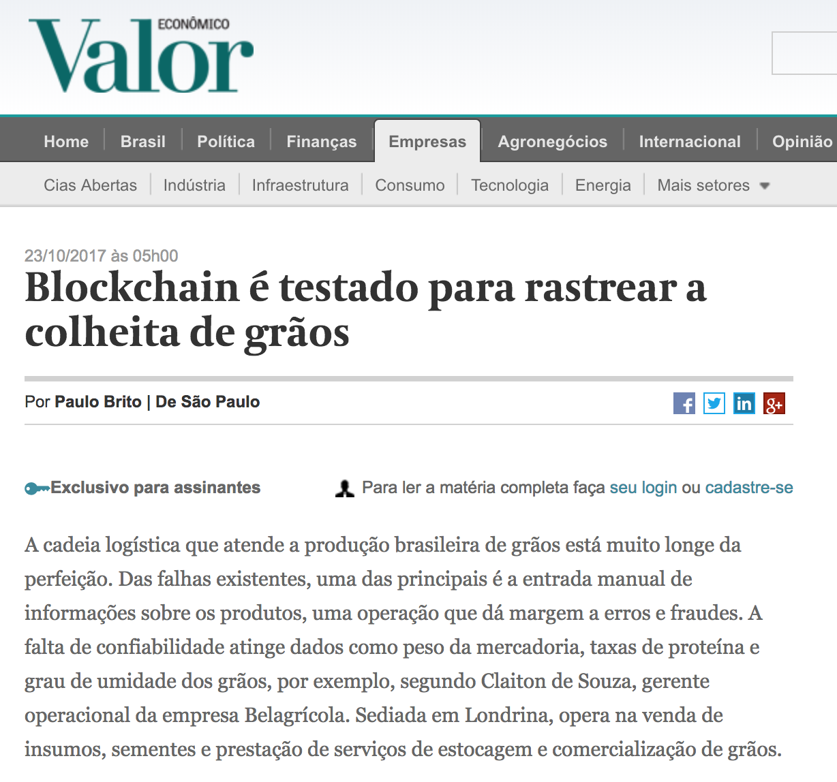
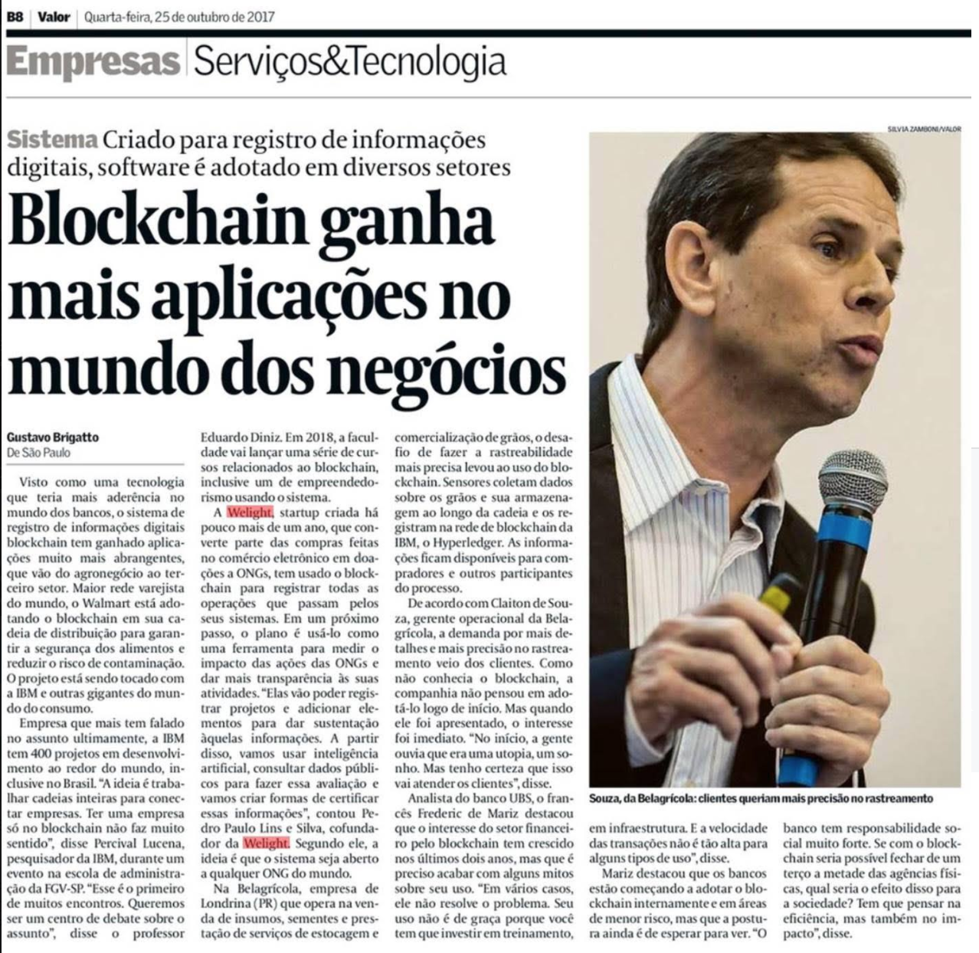
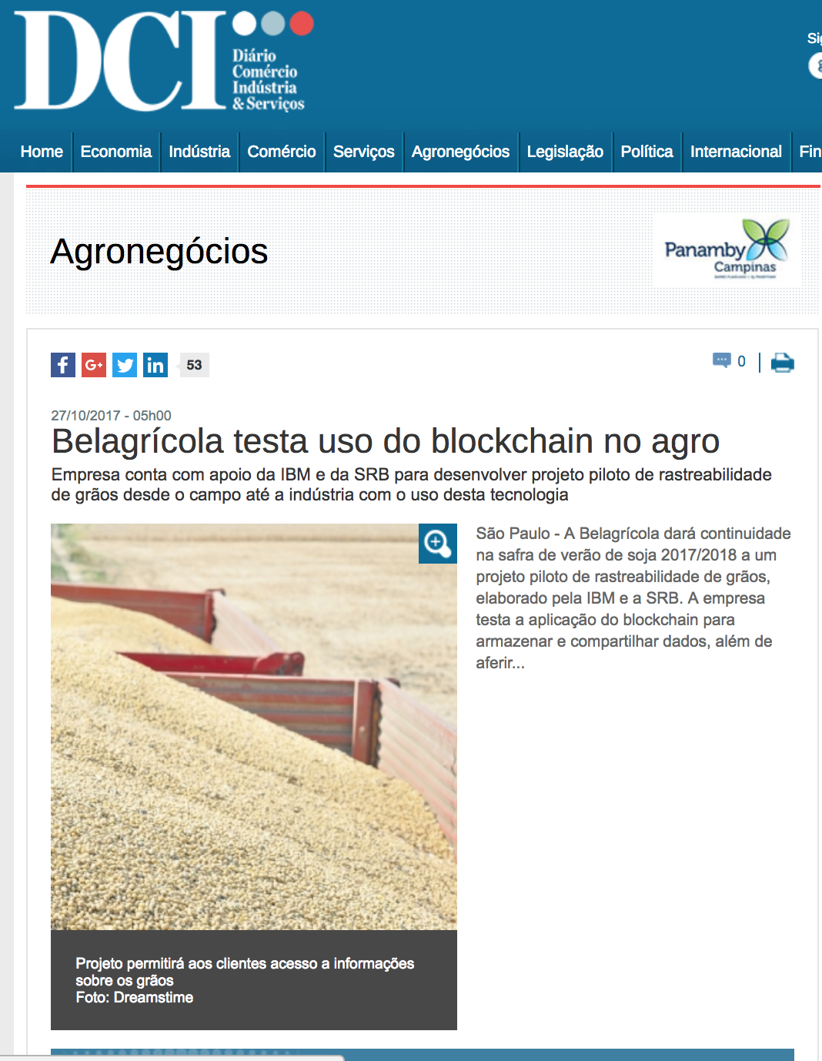
IBM Agritech – V 1.0 Bela Agricola

Slide 3
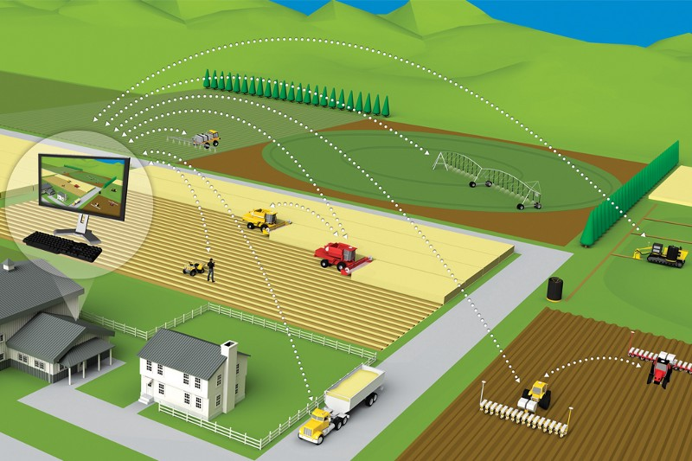
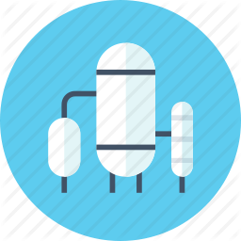


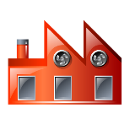

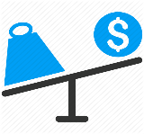


Agritech Blockchain Business Development Network
Source
BLOCKCHAIN SMART CONTRACTS
Quality Analysis
Grain Classification
Seed Royalties
Bart
Contract
Selling Contract
Selling Contract
BLOCKCHAIN CERTIFICATE

Slide 4
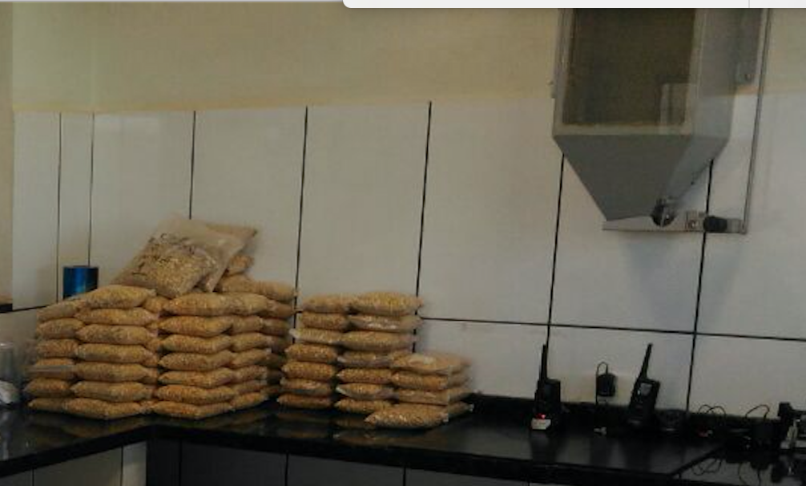
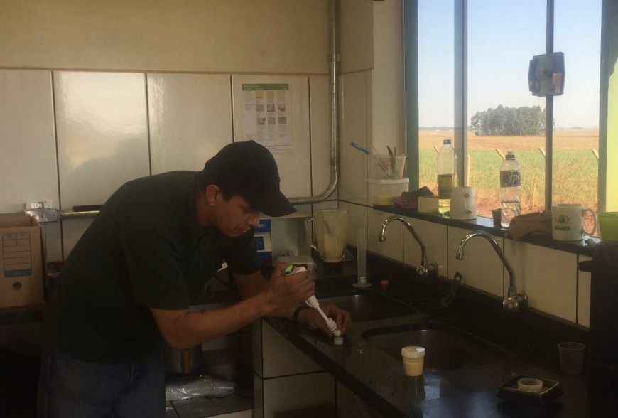
Agritech Blockchain

Slide 5
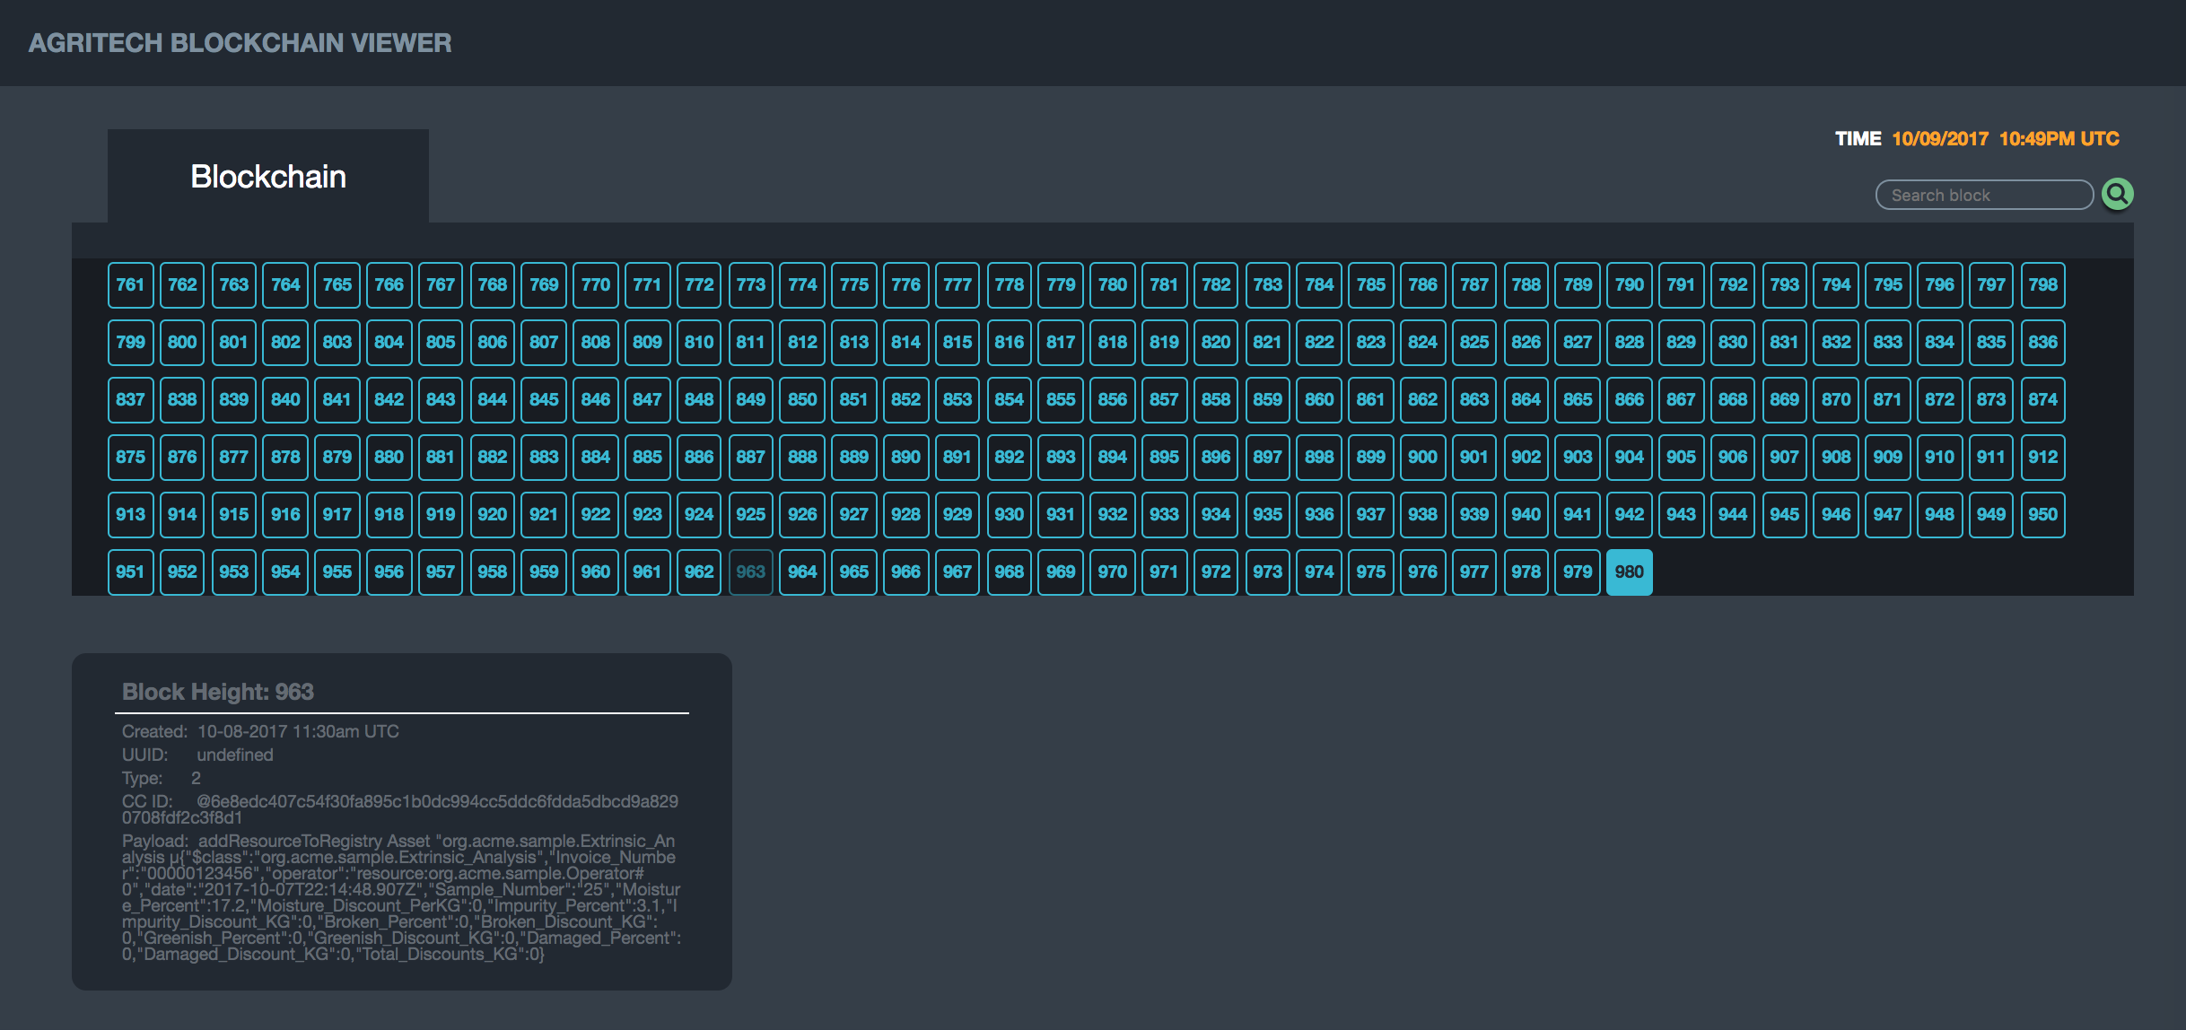
Blockchain para Ratreabilidade Digital de Lotes de Soja e Milho
Resultados de Testes Laboratoriais de Análise Intrinseca e Extrínseca de grãos gravados no Blockchain com IoT
Selo de Qualidade Digital do Lote
Diferencial competitivo: Garantia de procedência e de qualidade do Lote disponível para compradores: Tradings, Indústria Alimentícia

Slide 6
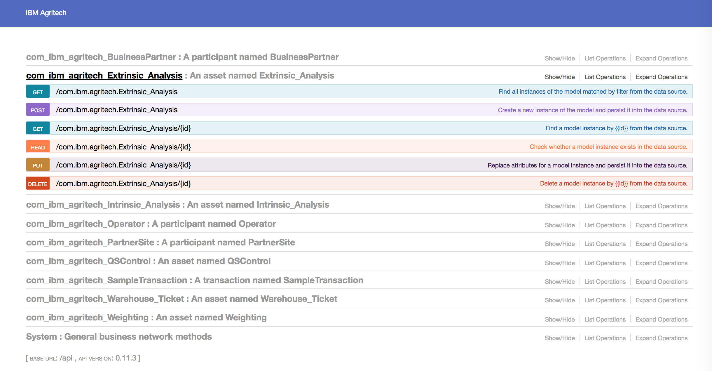
IBM Agritech Blockchain API

Slide 7
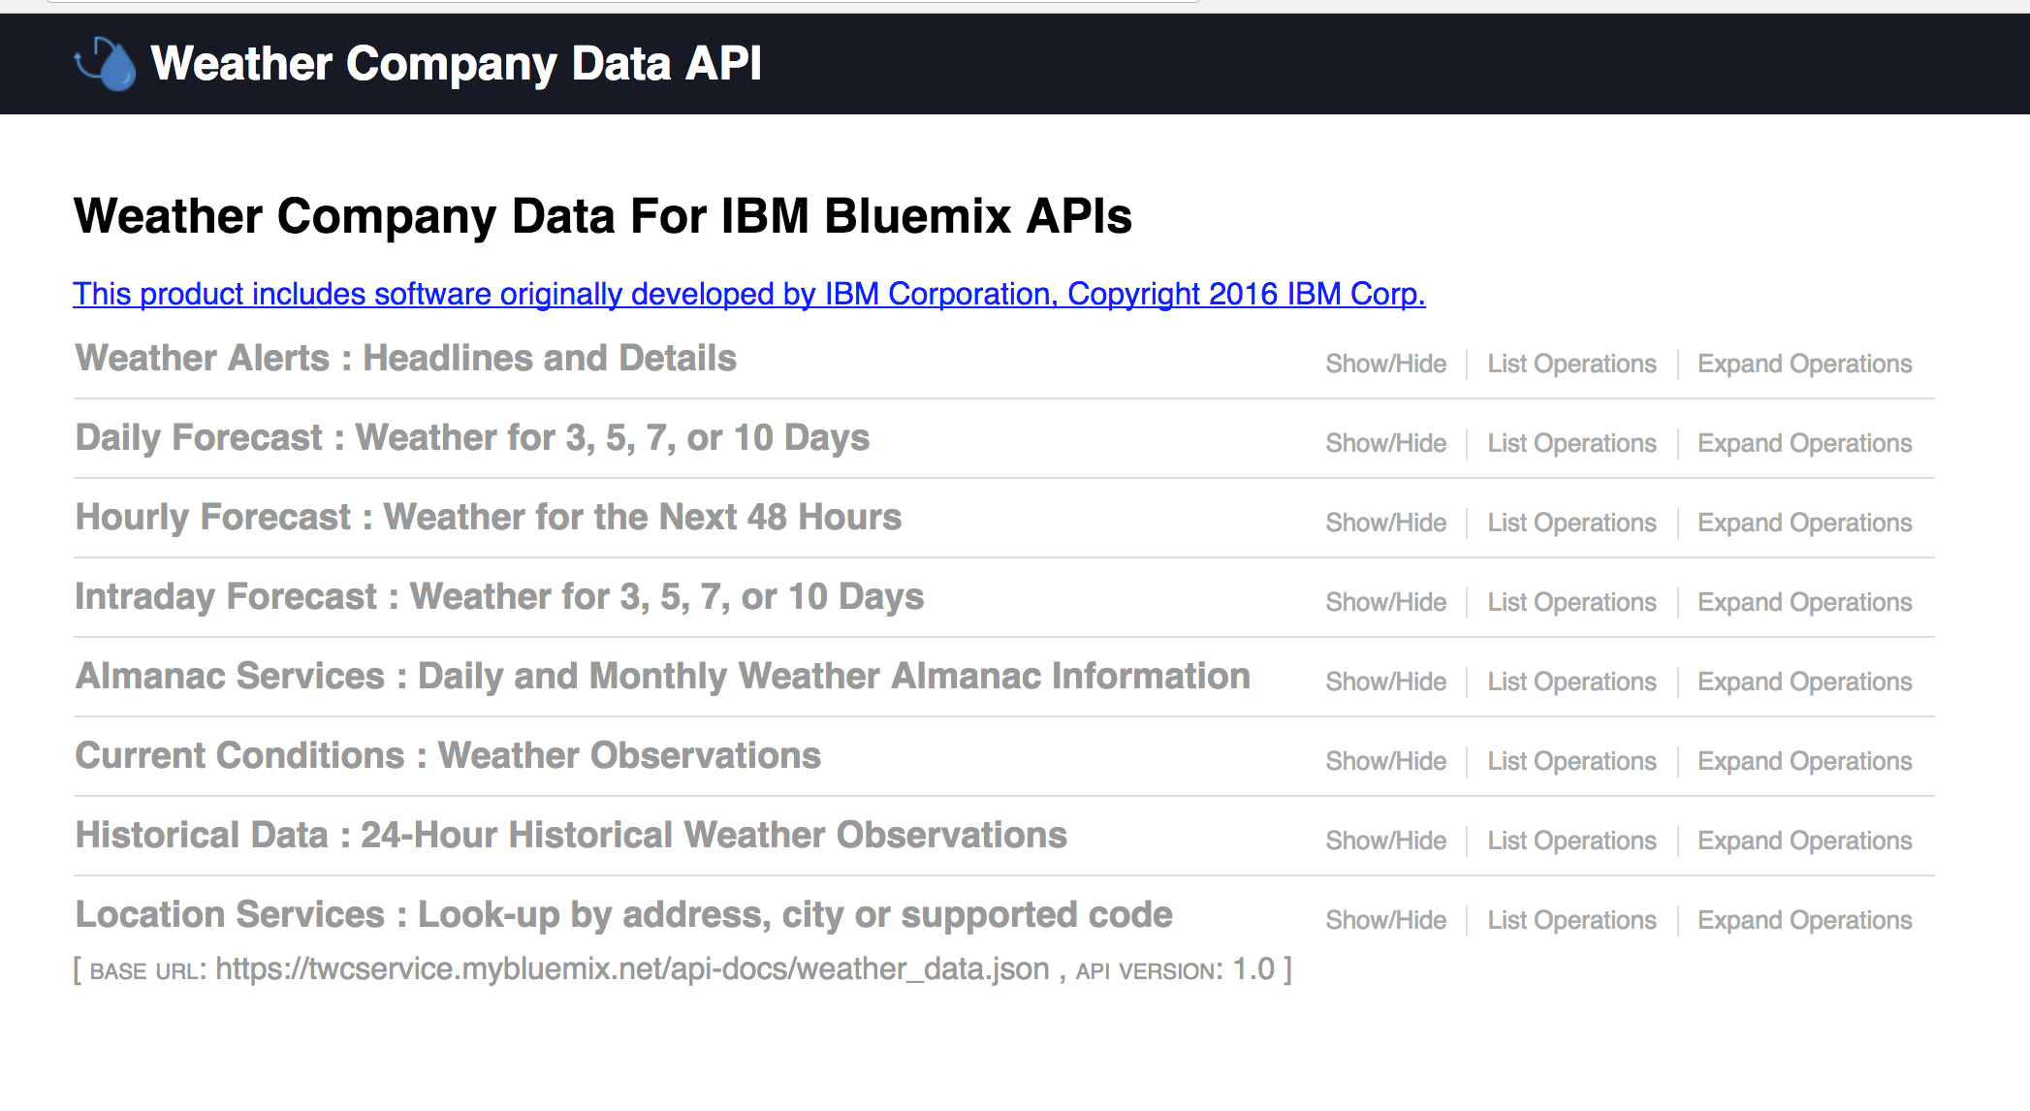
Weather Oracle

